Slide 1
GOES-R Program Update on Operational Products And GRB
Curtiss Burnett
Science Product Engineer
GOES-R Product Readiness and Operations (PRO) Team
Thomas Feroli, Jamie Daniels, Jim McNitt, Matt Seybold
CSPP Geo 2019
GOES-R Program Update on Operational Products And GRB
Chengdu, China
June 27, 2019
1
Notes:
T launch Dec 2021. U launch 2024

Slide 2
Message from Matt Seybold – PRO Lead
Thanks to the GOES-R Program's successful GRB simulator loan project during years preceding GOES-16 launch, 10 receiving systems were developed and available in the commercial market for clients wishing to receive GRB direct readout. Those same GRB customers also enjoyed the capability of producing their own L2 products using CSPP Geo. The GOES-R Program is pleased to be a long-time supporter of CSPP Geo software development and sees the readiness of the GRB community as a testament to the strong advance planning and development cooperation between commercial sector GRB receiving companies and GOES-R Program. Thank you to the GRB receiving companies, SSEC/CIMSS, and the GRB customers for all of their participation in making GRB data delivery a resounding success.

Slide 3
Outline
GOES-16 Product Validation Status
GOES-17 Product Validation Status
GRB Users and Rebroadcast Update
GOES-17 Thermal Control Anomaly Summary
GOES-17 Thermal Data Quality Flag (TDQF)
GOES-17 Thermal Anomaly Mitigations
Enterprise Algorithm Refresh
Notes:
ABI is at the end so stick around ☺

Slide 4
GOES-16/17 Product Validation Status

Slide 5
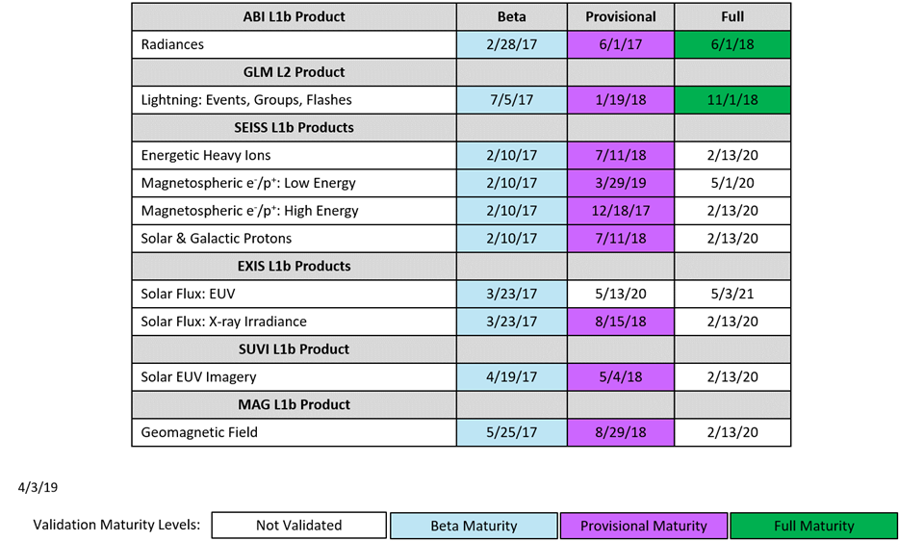
GOES-16 L1b Science Product Validation Status

Slide 6
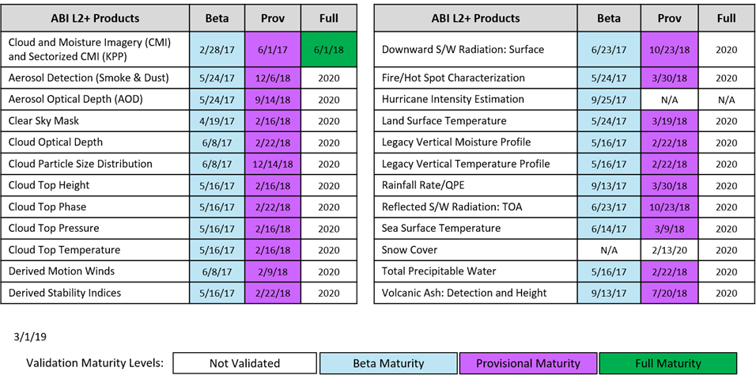
GOES-16 L2+ Science Product Validation Status

Slide 7
GOES-17 L1b Science Product Validation Status

Slide 8
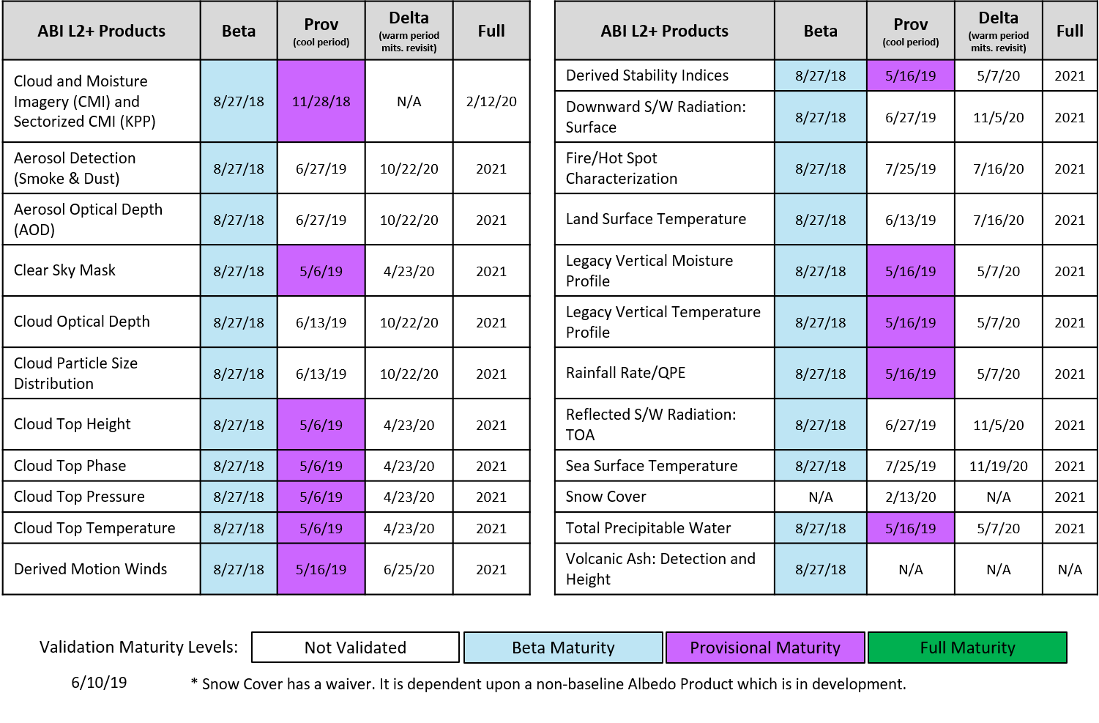
GOES-17 L2+ Science Product Validation Status
Notes:
LST Passed

Slide 9
GOES Rebroadcast (GRB) Update

Slide 10
GOES-R Series Data Access
Acronym | System Name
GRB | GOES Rebroadcast
HRIT/ EMWIN | High Rate Information Transmission/ Emergency Managers Weather Information Network
PDA | Product Distribution and Access
CLASS | Comprehensive Large Array-data Stewardship System
GNC-A | GEONETCast Americas
Websites | Websites on the Internet
BDP | Big Data Project
NOAAPort | NWS Satellite Broadcast Network
Notes:
GNC-A -- The service uses the commercial Intelsat-9 (IS-9) satellite to broadcast environmental and other observation data to an area covering most of North, Central, and South America. - https://www.geonetcastamericas.noaa.gov/
BDP - Noaa project that utilizes cloud and cloud computing. The cloud-computing platforms provide access to the following GOES-R series datasets: Rad, CMI, GLM L2+
Examples of cloud platforms include: Open Commons Consortium (OCC), AWS, Google Cloud Platform (ncdc.noaa.gov)
NoaaPort - Distribution of products via commercial communication satellite using C-Band (nws)

Slide 11
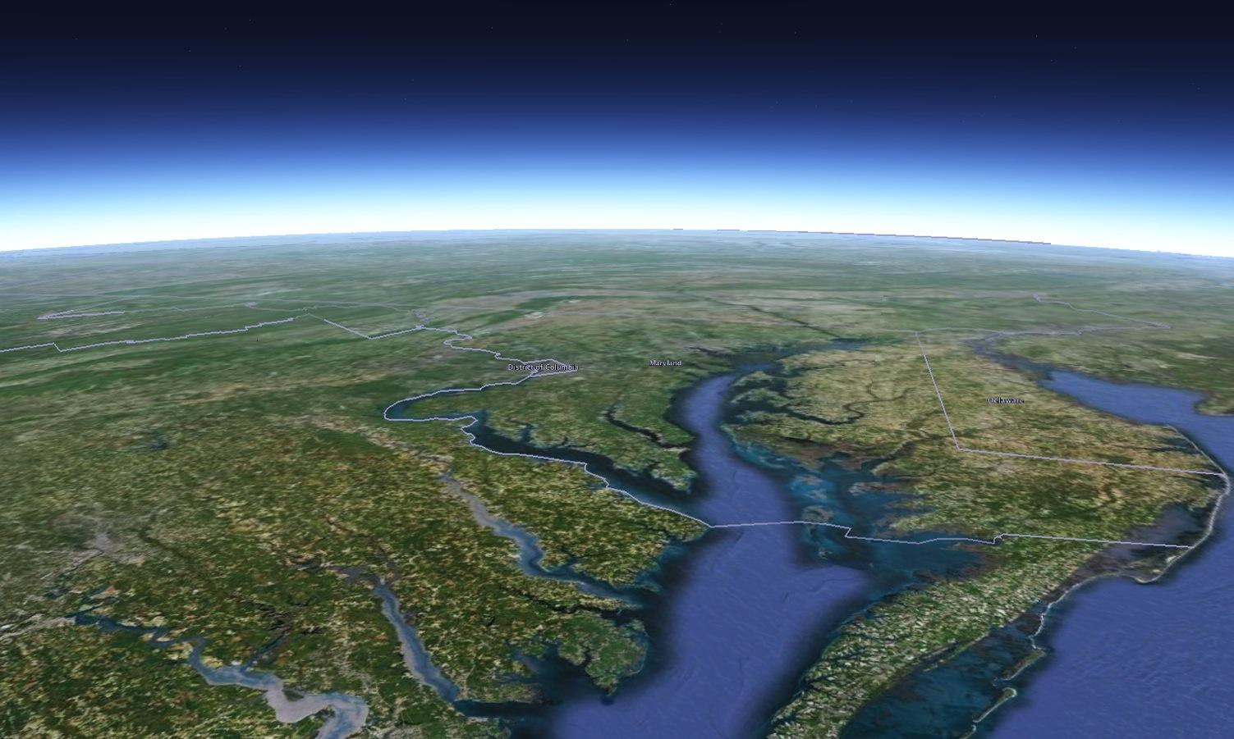
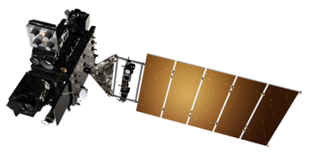
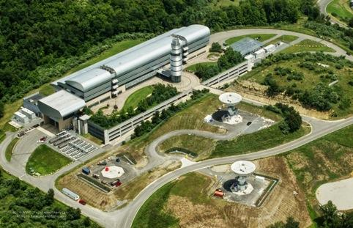
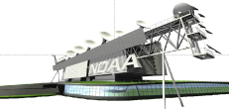
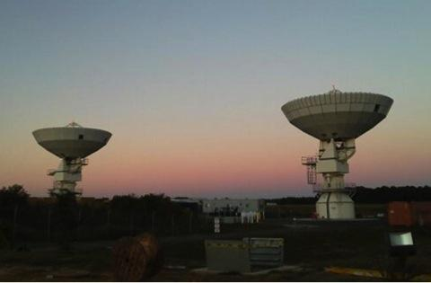
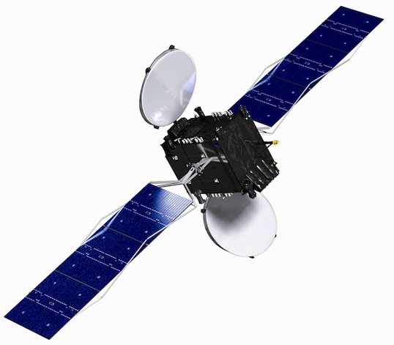
GOES-R Series Ground Systems Architecture
GRB Data Flow
GOES-West
137.2° West
GOES Storage
105° West
GOES-East
75.2° West
Consolidated Backup (CBU) Fairmont, WV
Command & Control, Mission Data, GRB, and HRIT/EMWIN
GRB and HRIT/EMWIN
GRB
Direct Broadcast Community
Instrument and Telemtry Data
GRB
SARSAT
DCS
SARSAT
Instrument and Telemtry Data
DCS
GRB, DCS, HRIT/EMWIN
NOAA Satellite Operations Facility (NSOF)
Suitland, MD
Command & Control, Mission Data,
L1B and L2+ Derived Products
PDA
L1B, L2+
AWIPS
NCFs
Climate Research and Academia
Sectorized Cloud and
Moisture Imagery
Authorized Operational Users
Wallops Command and
Data Acquisition Station (WCDAS)
Wallops, VA
SBN/NOAAPort
NOAA Port Community

Slide 12
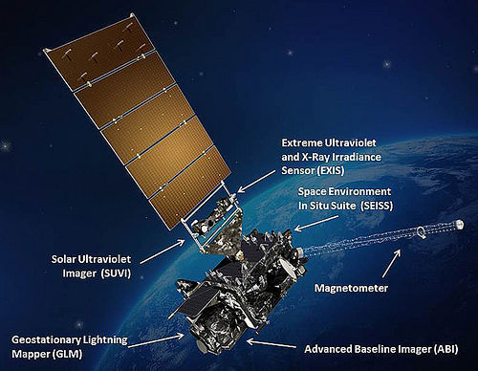
GOES-R Series Products on GRB
ABI L1b Products:
Radiances from the Advanced Baseline Imager: 16 Bands; Full Disk, CONUS, and Mesoscale
Space Weather L1b Products
Solar imagery from the Solar Ultraviolet Imager (SUVI)
Solar flux from the Extreme Ultraviolet and X-ray Irradiance Sensors (EXIS)
Energetic heavy ions from the Space Environment In-Situ Suite (SEISS)
Space environment magnetic field from the Magnetometer (MAG)
Level 2 Products
Geostationary Lightning Mapper Lightning Cluster Filter Algorithm (GLM)

Slide 13
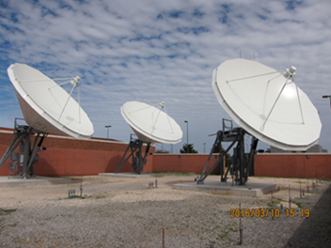
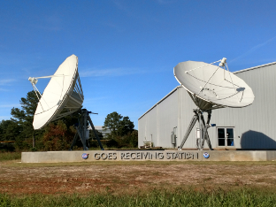
GOES Rebroadcast Reception
Reception of the GOES Rebroadcast (GRB) data is accomplished by means of a fixed dish antenna with a dual left and right hand circular feed horn connected to two Low Noise Amplifiers
The Low Noise Amplifiers outputs are connected to Radio Frequency/ Intermediate Frequency down-converters
The Radio Frequency/ Intermediate Frequency down-converters are connected to Digital Video Broadcasting-S2 (DVB-S2) capable receivers
Norman, Oklahoma
The GRB downlink signal from the satellite is at a center frequency of 1686.600 MHz and requires an Antenna gain-to-noise-temperature (G/T) of 15.2 dB/K for worst-case locations
Alaska

Slide 14
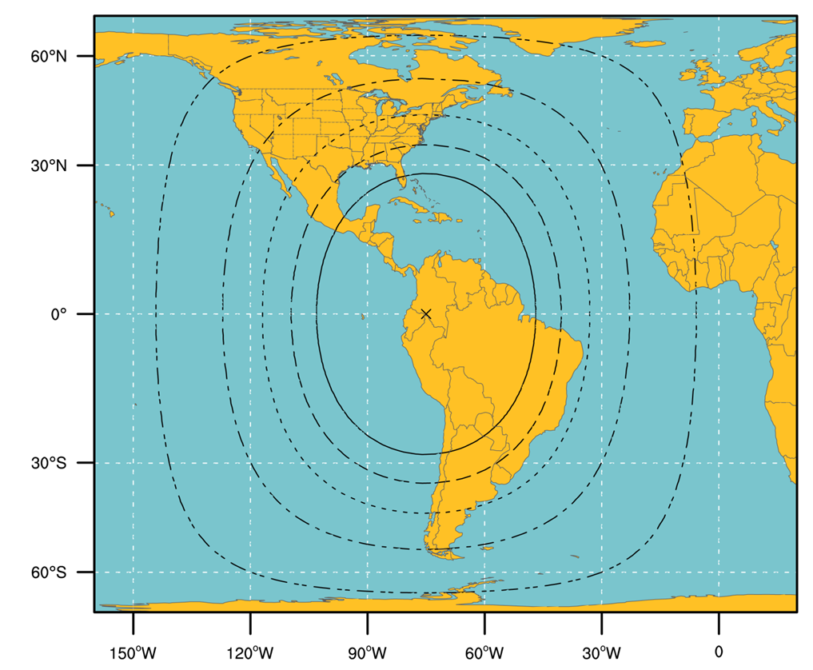
GOES-R Series GRB Ground Antenna Sizes
GOES West
GOES East
NOTES:
Calculations based on available data as of May 2011
Each antenna size is usable within the indicated contour
Rain attenuations included are: 1.3/1.6/2.0/2.2/2.5 dB (3.8 to 6 m)
An operating margin of 2.5 dB was included in the calculations, but users are warned that may not be enough in parts of North America where cellular and mobile internet service providers may provide strong interference and therefore additional antenna gain may be needed

Slide 15
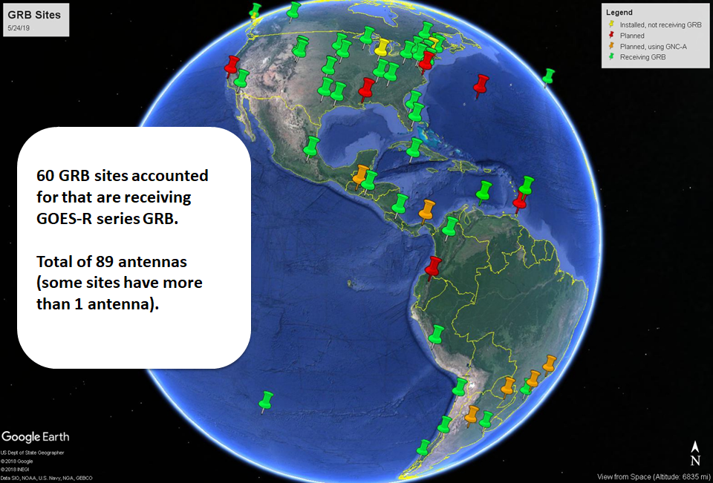
GOES-R GRB Sites

Slide 16
GRB User Group
There are 160 members in the GRB User Group
By participating in the GRB User Group and borrowing the GRB Simulators, the vendors, manufacturers, and system integrators were able to provide early support to GOES-16 users by providing software solutions for product generation
The GRB vendors, manufacturers, and system integrators are listed at: https://noaasis.noaa.gov/NOAASIS/ml/manulst.html
The GRB User Group meets by phone every three months
Prior to going live with a GOES-R ground system software patch that includes a GRB structural change, the GOES-R Product Readiness and Operations (PRO) Team provides the following to GRB users:
List of changes by Algorithm Discrepancy Report (ADR) and Work Request (WR) number
Redlines to the Product Definition and Users Guide (PUG) Volume 4
Test Data Files
OSPO chairs the GRB User Group. OSPO is updating the NOAASIS website with more information for GOES-R users: https://noaasis.noaa.gov

Slide 17
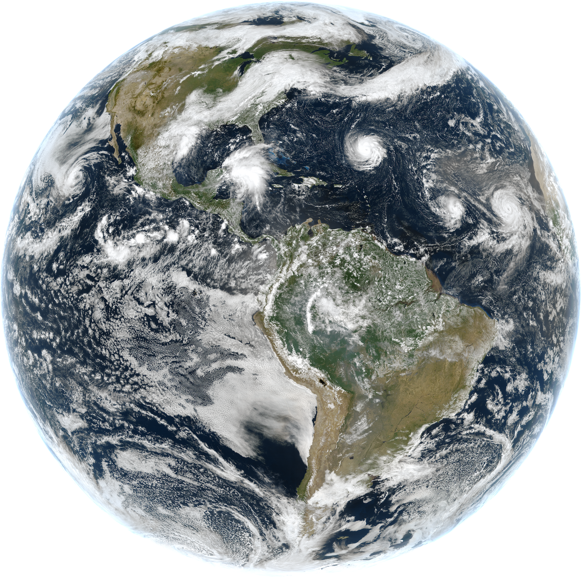
Community Satellite Processing Package for Geostationary Data
Funded by NOAA GOES-R Program to create and distribute software to process direct broadcast data from geostationary satellites, generating products in real-time
All software is free to download and use
Software is available to:
Process the GOES-16 and GOES-17 GRB data streams, reconstructing the products that were generated on the ground system
Further process GOES-16 ABI data to generate Level 2 products
Process direct broadcast data from GOES-15 and Himawari-8
Create high quality RGB and single band images in GeoTiff format
All software is free to download and use. Software is available at: http://cimss.ssec.wisc.edu/csppgeo/
ABI true color
ABI L1 Quicklooks
SUVI Imagery

Slide 18
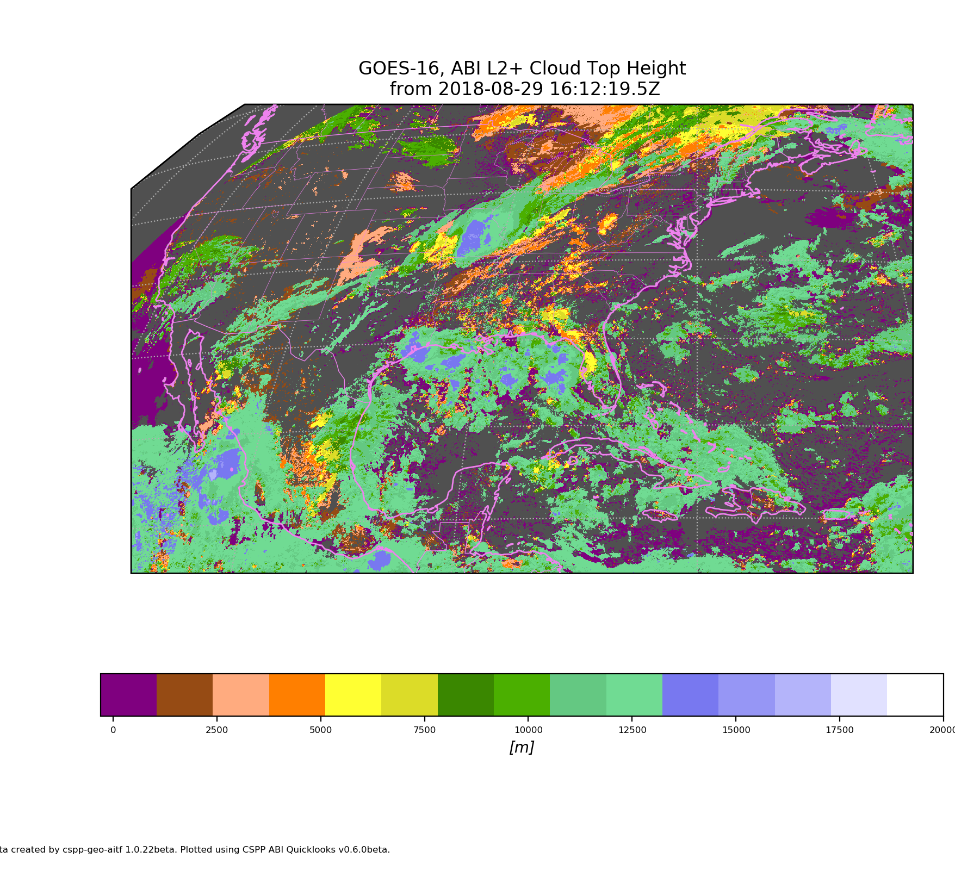
CSPP Geo Level 2 Processing
ABI Level 2 products are generated by research implementations of the operational algorithms, running in the “AIT Framework” which was developed at NOAA
Level 2 products are available in CSPP Geo AIT Framework Version 1 beta:
Aerosol Detection: Smoke and Dust
Cloud Top Height
Aerosol Optical Depth
Cloud Top Phase
Clear Sky Mask
Cloud Top Pressure
Cloud and Moisture Imagery
Cloud Top Temperature
Cloud Optical Depth (day/night)
Land Surface Temperature (skin)
Cloud Particle Size Distribution (day/night)
GOES-16 Cloud Top Height

Slide 19
Recent Changes to GRB
The DO.07.02.00 patch includes a unique Temperature Data Quality Flag (TDQF) and additional metadata to identify pixels and products impacted by high focal plane temperature. New data quality indicators are provided at both the pixel and product level
At the pixel level, DQF range is extended to include the new flag value 4
At the product level, additional metadata convey the configuration parameters, focal plane temperatures, and TDQF metrics
Build DO.07.02.00 went operational on April 8, 2018. Installation, Test, and Check-Out (ITCO) completed on May 6, 2019
Transition of GOES-16 and GOES-17 ABI to Mode 6 on April 2, 2019, as the default mode (replaced Mode 3 as Flex Mode). Continuous Full Disk Mode (mode 4) will continue to be a secondary operational mode

Slide 20
Summary
Many of the GRB sites generate GOES-16/17 data products for use in operations, product development, and research. GRB sites develop and generate new products, and tailor products to meet their users’ requirements. GRB sites distribute data products to additional users through:
Websites
Media
Other distribution paths
GRB users, including Univ. of Wisconsin SSEC/CIMSS, participated in the GOES-16 PLT and provided early feedback that resulted in Algorithm Discrepancy Reports (ADR) and Work Requests (WR) and participated in the GOES-17 PLT and provided feedback. GRB users were able to track progress on ADRs and WRs through the GRB User Group
Univ. of Wisconsin SSEC/CIMSS provided CSPP Geo software patches prior to the GOES-R Ground System going live with its patch so that CSPP Geo users would have a smooth transition. CSPP Geo data products are kept in sync with the operational products provided by OSPO through the PDA and CLASS

Slide 21
GOES-17 Thermal Control Anomaly Summary

Slide 22
Cryocoolers & LHP Model
Cryo Cooler
Primary
Heat
Focal Plane
Heat
Reject
Radiator
Loop Heat Pipes
Radiator
Redundant
Cryocoolers take heat from the ABI focal plane module (FPM) to a reject surface
Heat pipes pick up the heat and deliver it to the radiator
Both cryos are required to maintain FPM temperature

Slide 23
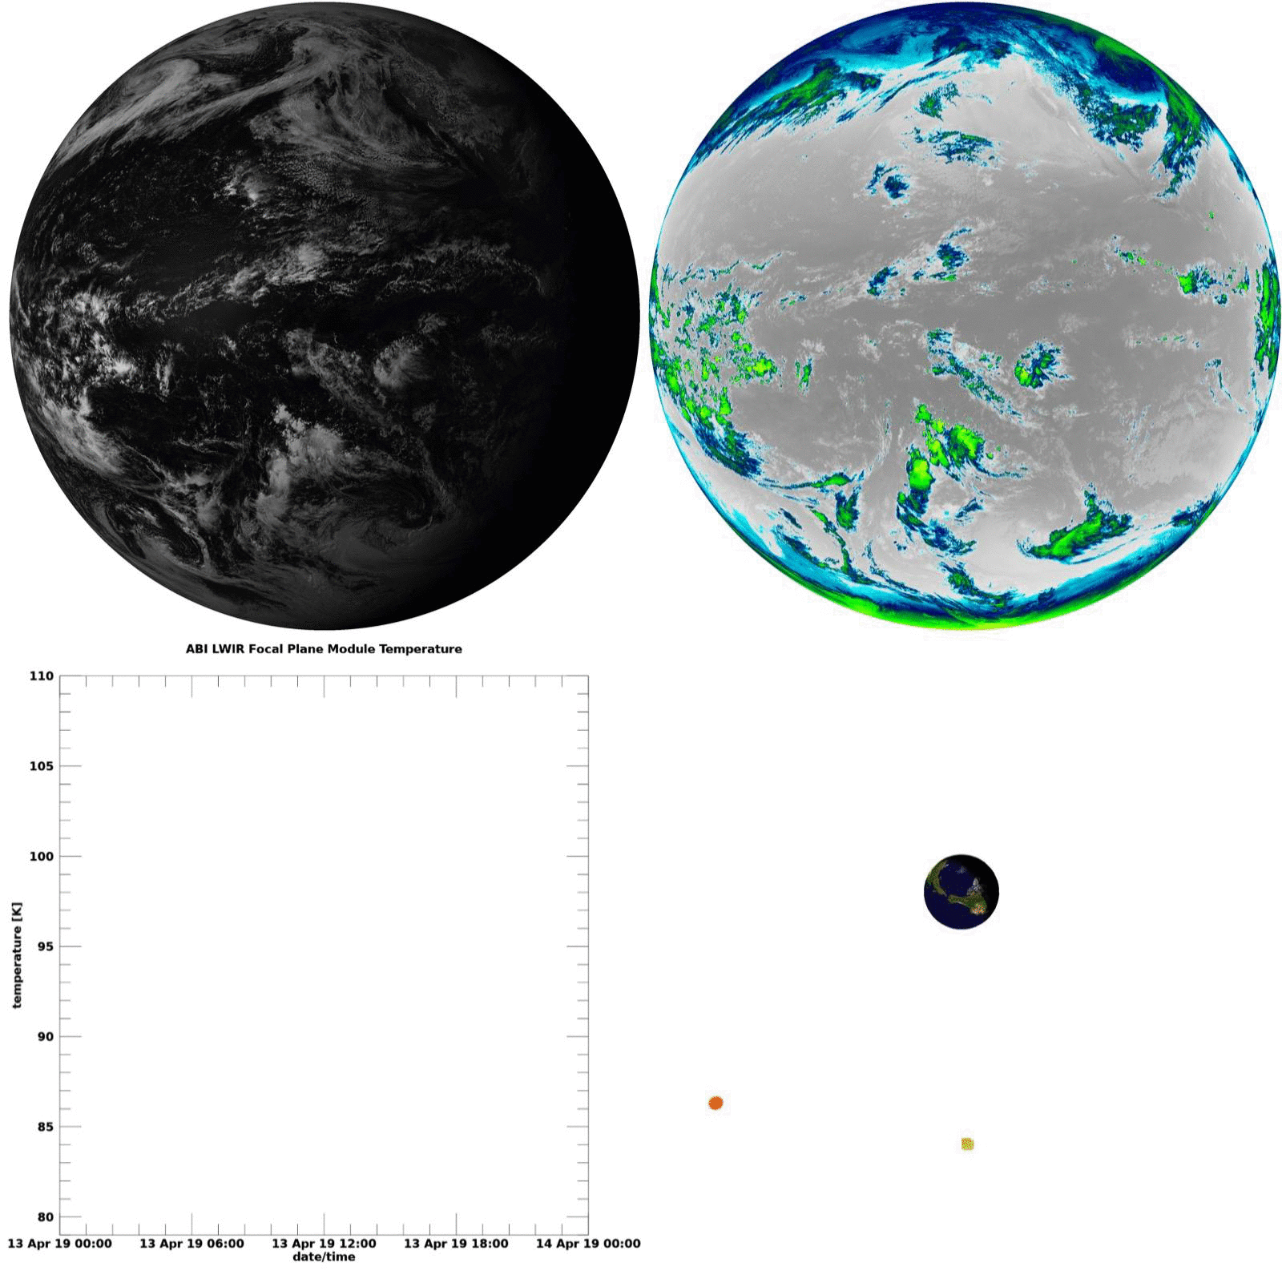
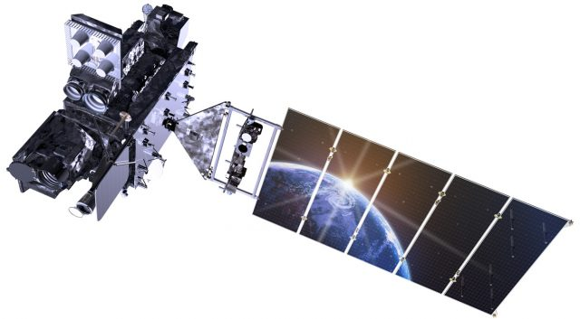
Cool animation here, maybe replace last 3 slides?
Band 2
0.64 µm
Band 12
9.61 µm
IR FPM Temperature
23

Slide 24
Annual Fluctuation of FPM Temperatures
G17 baseline operating temperature is 81 K, nominally is 60 K
We are here, in our twice annual ‘cool period’
Notes:
Focal plane module temperatures through the year

Slide 25
GOES-17 ABI Performance
Loop Heat Pipes on GOES-17 ABI not functioning properly
Loop Heat Pipes are not transferring expected thermal load to radiator
Results in loss of data from 7 infrared channels at warmest orbital conditions (before and after the vernal and autumnal equinoxes)
Water vapor (Ch 8, 9, 10), cloud top phase and ozone LWIR (Ch 11, 12), dirty and CO2 LWIR (Ch 15, 16)
Under worst case conditions, local emission and dark current noise cause the longer wavelength channels to saturate and become unusable for 3-6 hours overnight depending on channel
Optimization techniques successful in recovering >97% of planned ABI data
Operating IR detectors and cryocooler at higher set points
Reducing detector integration time and optimizing gain/bias settings
Performing semi-annual yaw flip to reduce solar load
ABI recently experienced a software error that resulted in degraded imagery
Not due to ongoing loop heat pipe issue
Recent update to software that controls the ABI cryocooler system experienced a memory error
Cryocooler operation was restored; imagery degradation was temporary and no longer expected
https://www.goes-r.gov/users/transitionToOperations17.html

Slide 26
GOES-17 TDQF Flag

Slide 27
TDQF Flag
Thermal Data Quality Flag implemented as a 4th state to the ABI data quality flag
Will be set when the maximum focal plane temperature is above the threshold for that band
Indicates that data is saturated due to the temperature of the focal plane

Slide 28
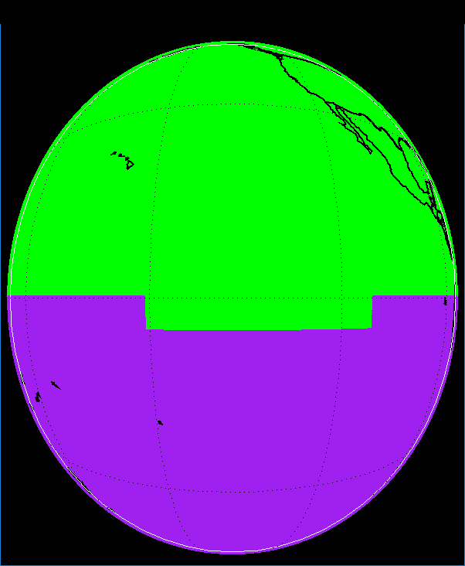
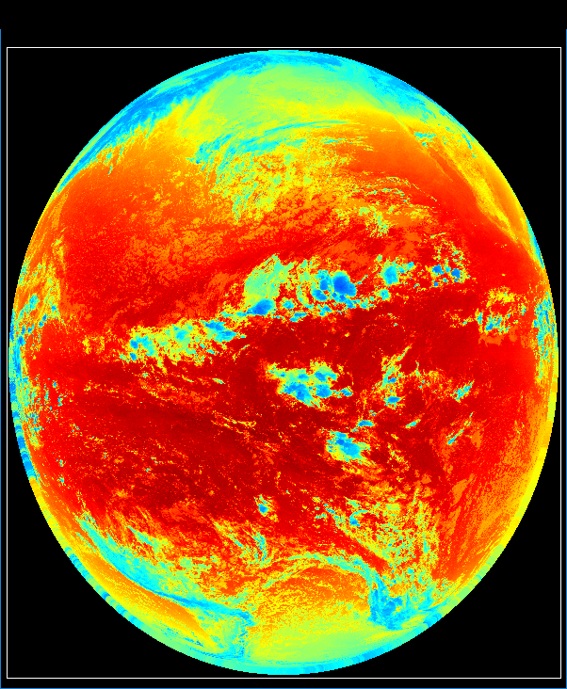
TDQF example: Apr. 10, 2019 at 10:20 UTC Band 12
TDQF state (DQF=4) reflects focal plane module temperature independent of pixel radiance
DQF = 0
(good data)
DQF = 4
(FPM T > threshold)
OR_ABI-L1b-RadF-M6C12_G17_s20191001020341_e20191001029413_c20191001029459.nc

Slide 29
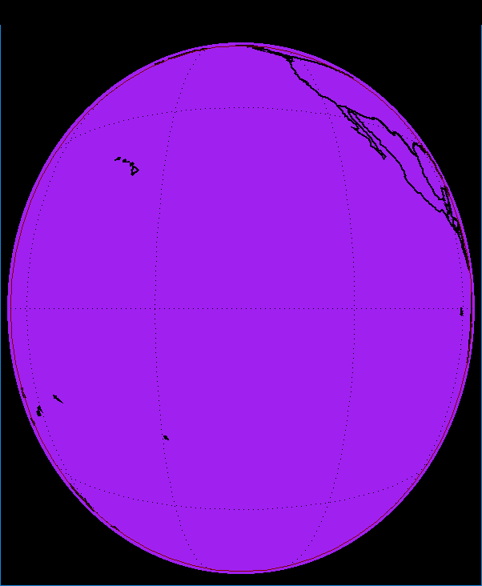
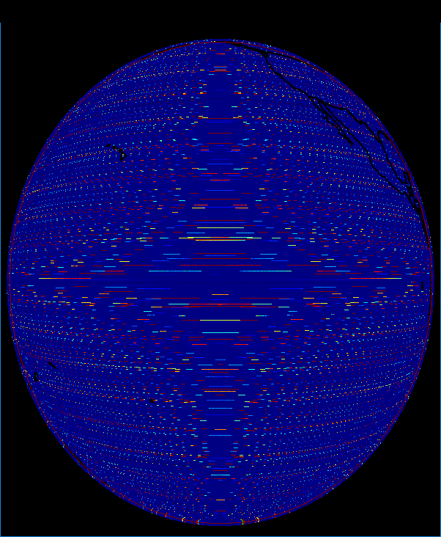
TDQF example: Apr. 26, 2019 at 12:20 UTC Band 12
TDQF state is reported when band saturation occurs, but the saturation condition (previous DQF=2) is masked.
DQF = 4
(FPM T > threshold)
OR_ABI-L1b-RadF-M6C12_G17_s20191161220341_e20191161229413_c20191161229453.nc

Slide 30
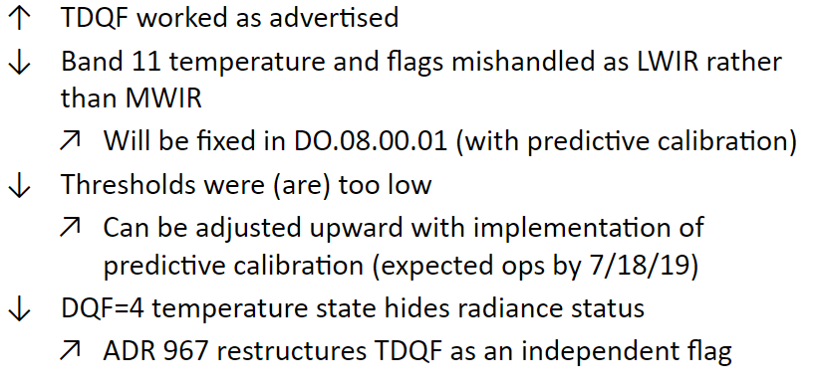
Good news ↑, bad news ↓, and looking up ↗

Slide 31
New and improved TDQF approach
Create a TDQF independent of the previous DQF states
Allows previous state values to convey useful information
Additional summary metadata will be needed
ADR 967 “Loss of data quality info at high FPM temperature”
Possible implementation:
Current baseline |  |  |  | Proposed approach |  |  |  | Meaning
0 | 0 | 0 | DQF = 0 | X | 0 | 0 | DQF = 0, 4 | Good pixel
0 | 0 | 1 | DQF = 1 | X | 0 | 1 | DQF = 1, 5 | Conditional pixel
0 | 1 | 0 | DQF = 2 | X | 1 | 0 | DQF = 2, 6 | Out of range (sat/undersat)
0 | 1 | 1 | DQF = 3 | X | 1 | 1 | DQF = 3, 7 | Missing pixel
1 | 0 | 0 | DQF = 4 | 1 | X | X | DQF ≥ 4 | FPM temperature threshold exceeded
“TDQF” is a flag state enumeration
TDQF becomes an explicit 1-bit flag

Slide 32
GOES-17 Thermal Anomaly Mitigations

Slide 33
ABI L2+ LHP Mitigation Strategy
Due to the LHP anomaly, Program and STAR are working towards implementing:
FPM temperature based DQFs on a per product basis
Band swapping based on the DQF
For example, implementing logic to swap B13 for B14 in the Fires algorithm
Enterprise Algorithms: updated science and dynamic band swapping
The review process for implementing these updates reflects resource prioritization. Validation reviews will occur during 2020 in order of algorithm precedence and readiness.

Slide 34
Enterprise Refresh

Slide 35
Enterprise Algorithms
Algorithms created for use on geostationary or polar orbiting satellite systems
Data from various missions can be swath or gridded, projected differently, distributed in different file formats, have different metadata standards, etc.
Being developed by STAR to bring science updates into a new GOES-R baseline
Will be deployed in the coming years and will be modified to account for the GOES-17 loop heat pipe anomaly

Slide 36
Enterprise Algorithm Stack
LEO Ground System
GEO Ground System
Enterprise Interface
LEO Specific Code/Logic
GEO Specific Code/Logic
Enterprise Science Code

Slide 37
Enterprise Algorithm Development
STAR Framework 2.0
JPSS Data
Science Algorithm
GOES-R Data
GOES-R GS
PRO PASS Wrapper
Science Algorithm

Slide 38
Roles and Responsibilities
Science Team
Develop LHP Mitigation Strategies
Work mitigations into algorithm
Review output
STAR ASSISTT
Integrate the *unmitigated* algorithm into the Framework 2.0
Will need to assume FPT and extra channels as input
Work mitigation updates into the Framework integrated algorithm
PRO PASS
Develop wrapper for *unmitigated* algorithm, but provide FPT and extra channels as input
Work mitigation updates into the wrapped algorithm on the GOES-R ground system

Slide 39
Parallel Development
While the science teams begin working on developing mitigations for a specific algorithm the ASSISTT team is integrating the existing algorithm without (w/o) mitigations while leaving ‘hooks in place’ for FPT to be passed in
This will allow for PRO PASS to begin working on the wrapping of the Enterprise Algorithm (EA)
When the science team is finished most of the time consuming work will be completed by PRO PASS
Science Team
STAR ASSISTT
PRO PASS
Mitigation
Review
EA w/o
EA w/
EA w/o
EA w/

Slide 40
GOES-17 L2+ Science Product
LHP Mitigations & Delta Val. Status
Complete
In Progress
Not Started/ECD
Not Started/ECD Changed
Component | Mitigation Delivery (AWG) | Mitigation DE Install (PRO) | Mitigation OE Install (PRO) | Warm Period Provisional Revisit (AWG)
Clear Sky Masks (A. Heidinger, AWG) | 11/12/2019 | 1/2/2020 | 1/23/2020 | 4/14/2020
Cloud Top Phase (M. Pavolonis, AWG) | 11/12/2019 | 1/2/2020 | 1/23/2020 | 4/14/2020
Cloud Top Height (A. Heidinger, AWG) | 11/12/2019 | 1/2/2020 | 1/23/2020 | 4/14/2020
Cloud Top Pressure (A. Heidinger, AWG) | 11/12/2019 | 1/2/2020 | 1/23/2020 | 4/14/2020
Cloud Top Temperature (A. Heidinger, AWG) | 11/12/2019 | 1/2/2020 | 1/23/2020 | 4/14/2020
Derived Motion Winds (J. Daniels, AWG) | 9/9/2019 | 11/14/2019 | 12/6/2019 | 4/2/2020
Cloud Optical Depth (A. Heidinger, AWG) | 3/24/2020 | 5/5/2020 | 5/27/2020 | 9/29/2020
Cloud Particle Size Dist. (A. Heidinger, AWG) | 3/24/2020 | 5/5/2020 | 5/27/2020 | 9/29/2020

Slide 41
GOES-17 L2+ Science Product
LHP Mitigations & Delta Val. Status
Complete
In Progress
Not Started/ECD
Not Started/ECD Changed
Component | Mitigation Delivery (AWG) | Mitigation DE Install (PRO) | Mitigation OE Install (PRO) | Warm Period Provisional Revisit (AWG)
Rainfall Rate/QPE (B. Kuligowski, AWG) | 12/24/2019 | 2/14/2020 | 3/6/2020 | 6/11/2020
Aerosol Optical Depth (I. Laszlo, AWG) | 3/24/2020 | 5/5/2020 | 5/27/2020 | 9/29/2020
Aerosol Detection (S. Kondragunta, AWG) | 3/24/2020 | 5/5/2020 | 5/27/2020 | 9/29/2020
Land Surface Temperature (B. Yu, AWG) | 2/11/2020 | 5/1/2020 | 5/22/2020 | 9/29/2020
Volcanic Ash: Detection/Height (M. Pavolonis, AWG) | 2/11/2020 | 5/22/2020 | 6/15/2020 | 10/13/2020
Fire Hot Spot Characterization (I. Csiszar, AWG) | 2/11/2020 | 5/22/2020 | 6/15/2020 | 10/13/2020

Slide 42
GOES-17 L2+ Science Product LHP Mitigations & Delta Val. Status
Complete
In Progress
Not Started/ECD
Not Started/ECD Changed
Component | Mitigation Delivery (AWG) | Mitigation DE Install (PRO) | Mitigation OE Install (PRO) | Warm Period Provisional Revisit (AWG)
Soundings - Legacy Vertical Moisture Profile (T. Schmit, AWG) | 12/24/2019 | 7/6/2020 | 7/27/2020 | 10/19/2020
Soundings - Legacy Vertical Temp Profile (T. Schmit, AWG) | 12/24/2019 | 7/6/2020 | 7/27/2020 | 10/19/2020
Soundings - TPW (T. Schmit, AWG) | 12/24/2019 | 7/6/2020 | 7/27/2020 | 10/19/2020
Soundings - Derived Stability Indices (T. Schmit, AWG) | 12/24/2019 | 7/6/2020 | 7/27/2020 | 10/19/2020
Sea Surface Temperature (A. Ignatov, AWG) | 4/28/2020 | 8/3/2020 | 8/24/2020 | 10/8/2020

Slide 43
GOES-17 L2+ Science Product
LHP Mitigations & Delta Val. Status
Complete
In Progress
Not Started/ECD
Not Started/ECD Changed
Component | Mitigation Delivery (AWG) | Mitigation DE Install (PRO) | Mitigation OE Install (PRO) | Warm Period Provisional Revisit (AWG)
Downward Solar Insolation (SFC) (I. Laszlo, AWG) | 5/5/2020 | 8/3/2020 | 8/24/2020 | 10/8/2020
Reflected Solar Insolation (TOA) (I. Laszlo, AWG) | 5/5/2020 | 8/3/2020 | 8/24/2020 | 10/8/2020
Aerosol Particle Size (I. Laszlo, AWG) | 6/9/2020 | 8/10/2020 | 8/31/2020 | 10/15/2020
Cloud Cover Layer (A. Heidinger, AWG) | 6/9/2020 | 9/9/2020 | 9/30/2020 | 11/5/2020
Ice Concentration & Extent (J. Key, AWG) | 6/9/2020 | 10/7/2020 | 10/28/2020 | 2/28/2021
Ice Age & Thickness (J. Key, AWG) | 6/9/2020 | 10/14/2020 | 11/4/2020 | 2/28/2021
Ice Motion (J. Key, AWG) | 6/9/2020 | 11/4/2020 | 11/25/2020 | 2/28/2021
Land Surface Albedo (J. Key, AWG) | 12/12/2019 | 12/3/2020 | 12/24/2020 | 4/7/2021
Snow Cover (J. Key, AWG) | 4/18/2020 | 12/10/2020 | 1/8/2021 | 4/21/2021

Slide 44
Thank you!
Curtiss.Burnett@noaa.gov
For further questions, or questions I cannot answer, please contact:
For data and Program related questions: matthew.seybold@noaa.gov
For GRB and GRB Users questions: james.mcnitt@noaa.gov
For Enterprise and Schedule questions: thomas.feroli@noaa.gov

